Slide 1
Engineering Design
Computer Engineering as a Discipline

Slide 2
Basic Design Process
Need for Product / Service
Problem Definition & Understanding
Research Preparation
Conceptualization
Synthesis
Evaluation
Presentation
Optimization
Chapter 3 Engineering Design Process, Engineering Fundamentals, Saeed Moaveni PP 41 – 46

Slide 3
Basic Design Process
Need for Product / Service
Problem Definition & Understanding
Research Preparation
Conceptualization
Synthesis
Evaluation
Is there a real need for this?
Why?

Slide 4
Basic Design Process
Need for Product / Service
Problem Definition & Understanding
Research Preparation
Conceptualization
Synthesis
Evaluation
What does it really solve?
How does it solve it?

Slide 5
Basic Design Process
Need for Product / Service
Problem Definition & Understanding
Research Preparation
Conceptualization
Synthesis
Evaluation
Why do we need to solve it?
Who benefits from it?

Slide 6
Basic Design Process
Need for Product / Service
Problem Definition & Understanding
Research Preparation
Conceptualization
Synthesis
Evaluation
What solutions can you create to address the problem?
What do you need to create these solutions?
How do you merge components to come out the the ideal solution?
How much will it cost?

Slide 7
Advanced Ideas in Conceptualization
Instructors Recommended Approach
Teoriya Resheniya Izobretatelskikh Zadatch (TRIZ)
The ideal solution is one that:
Occupies no Space
Has no Mass
Consumes no Energy
Costs Nothing
Solutions
Mass
Space
Energy
Cost

Slide 8
Example: Writing data results in micro-gravity environment
NASA USA Solution
USSR Solution
Cost: 1M USD Supposedly
Technology:
Hermetically Sealed and Pressurized Ink Well and ball point tip
Works in Micro and Zero G Environments
Mass = 20g
Cost: 0.55 Cents
Technology
Graphite Encased in two laminated wood panels. Needs Sharpening only
Can work in Micro-Gravity and Zero Gravity Environments and wet environments.
Mass 20g

Slide 9


Example: Writing data results in micro-gravity environment
NASA USA Solution
USSR Solution

Slide 10
Example: Writing data results in micro-gravity environment
Energy: Melt and Form Metal
Pressurize and Seal Vessel
Energy: Make ruber, Metal Forming and Melting, Wood and Graphite Cutting and Lamination

Slide 11
Basic Design Process
Need for Product / Service
Problem Definition & Understanding
Research Preparation
Conceptualization
Synthesis
Evaluation
Figuring out what works as viable solutions to the problem.
Granted limit in
Materials
Time
Manpower
Funding

Slide 12
Basic Design Process
Need for Product / Service
Problem Definition & Understanding
Research Preparation
Conceptualization
Synthesis
Evaluation
Does it really do the task set?
How do you go about testing it?
How easy is it use use / operate? (Usability)
How effective is the solution? (Efficacy)

Slide 13
Evaluation
Human Testing / Animal Testing
Protocol / Rules on how its done
Objectives
Removal of Bias
Data Handling and Interpretation
Informed Consent (Human Testing Only)
Liability and Risk Reduction (Human and Animal Testing)

Slide 14
Basic Design Process: Optimization
Adjustment of Concepts
Adjustment Synthesis
Evaluation
How can its performance be improved?

Slide 15
Design Process Final Step
Presentation
Problem
Solution
Capacity of Solution
Cost
Effectively of a solution
Examples
Product Pitch
Conference Presentation
Journal Publication
Other Examples
Demonstration of Product

Slide 16
Summary of Engineering Thinking Design Process
Stage | Area | Subjects
Needs Establishment | Specific to Requirement | Social Sciences, Current Affairs
Problem Definition and Understanding |  | English / Filipino Interview Process or Reading of Related Literature
Preparation Research | General Body of Knowledge | Reading areas related to the problem as past solutions or current ones
Conceptualization | Specific to Area of Expertise | Professional Subjects
Synthesis
Evaluation | Testing Process | Statistical Design of Experiments
Optimization | Specific to Area of Expertise | Professional Subjects
Presentation | Venue to Present | English Communication Skills

Slide 17
Other Elements in Design Process
Standards Enforcement (Engineering Management)
Planning and Budgeting (Basic Accounting)
Staffing (General Engineering)
Audit Process for Administrative Area (Accounting and Engineering Management)

Slide 18
Advanced Ideas for the Design Process
Instructors Recommendation not Part of Syllabus
Design Sprint
Five Day Inventive Process to address issues using the least amount of time needed.
Monday
Map out Problem
Choose what to Focus On
Tuesday
Sketch a Set of Solutions on Paper
Wednesday
Critique each solution individually
Thursday
Friday
Vote on the best solutions
Fabricate the solution with highest votes
Test them using humans

Slide 19
Advanced Ideas in Design Process
Instructors Recommendation not Part of Syllabus
Design Thinking
The inability of a design to consider human nature and human behavior the product ability to access the market or to be considered by the market as usable.
Test
Prototype
Ideate
Define
Empathize

Slide 20
Advanced Ideas in Design Process
Instructors Recommendation not Part of Syllabus
Design Thinking
Engineering Thinking
Test
Prototype
Ideate
Define
Empathize
Ask
Imagine
Plan
Create
Experiment
Improve

Slide 21
Advanced Ideas in Design Process
Instructors Recommendation not Part of Syllabus
Design Thinking
Engineering Thinking
Test
Prototype
Ideate
Define
Empathize
Focuses on the solution to the Problem
Ask
Imagine
Plan
Create
Experiment
Improve

Slide 22
Advanced Ideas in Design Process
Instructors Recommendation not Part of Syllabus
Design Thinking
Engineering Thinking
Focuses on the user of the solution
Focuses on the solution to the Problem
Test
Prototype
Ideate
Define
Empathize
Ask
Imagine
Plan
Create
Experiment
Improve

Slide 23
Why Design Thinking rather than Engineering Thinking
Instructors Recommendation not Part of Syllabus
Flexibility of use
Deals with the issue of product commercialization first rather than later.
Test
Prototype
Ideate
Define
Empathize

Slide 24
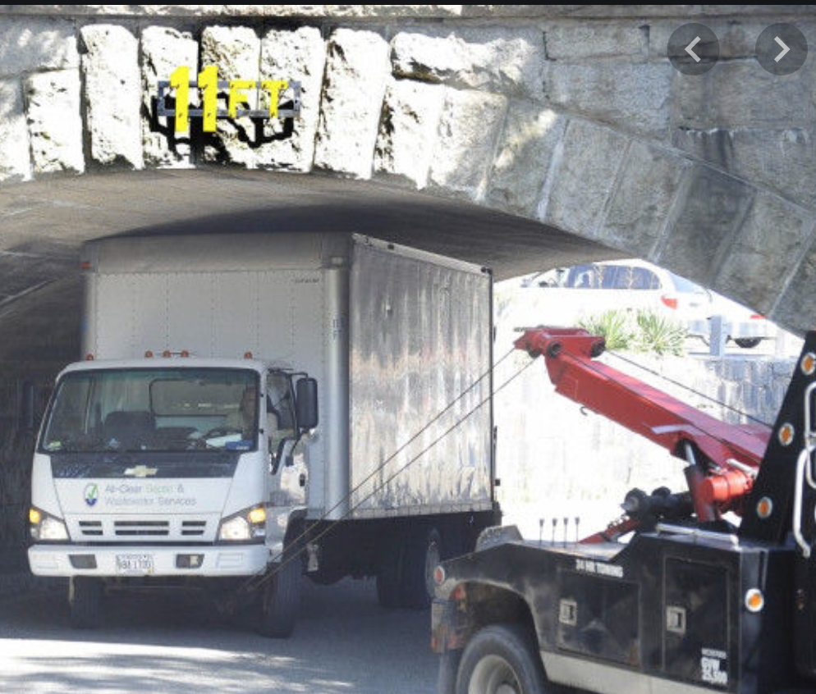
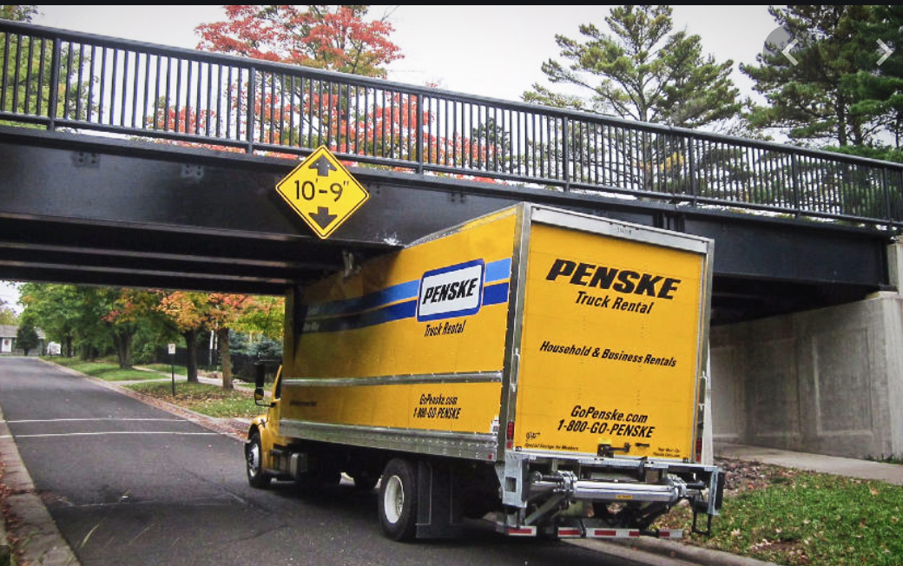
Examples

